Slide 1
IT Security 2
Unit 4 – Admin Accounts
Instructor: Brian Krause

Slide 2
Announcements
Class Questions Results
IT Club Meeting this Wednesday at noon!
Cool source of news: PAN Unit 42 https://unit42.paloaltonetworks.com/
Notes:
Any questions or concerns about class?
Questions from the quiz? Can bring that up from unit 3 folder.
If I didn’t answer your questions well enough online let me know and I can answer them outside of blackboard or right here, right now.

Slide 3
Admin Account Overview
Some slides were adapted from Palo-Alto for use in this class. Content is a mesh between vendor provided information and instructor comments.

Slide 4

Flow Logic of the Next-Generation Firewall
Notes:
What are the 4 main steps the Firewall goes through when checking traffic?
High level flow:
Session - setup
Inspection – of traffic
Enforcement – of policy
Forward – along traffic
For more information about the packet handling sequence inside of a PAN-OS® device, see the Packet Flow Sequence in PAN-OS document available on the Palo Alto Networks Support website at https://live.paloaltonetworks.com/docs/DOC-1628.

Slide 5
Flow Logic of the Next-Generation Firewall
Session Setup
Does traffic match to an existing session?
Source Zone
Zone and/or DoS Protection
Forwarding Lookup
(PBF)
Destination Zone
(plus DNAT check)
Security Policy Check
(App-ID ignored)
Assign Session ID
No
Yes
Inspection and Enforcement
INSPECTION
ENFORCEMENT
App-ID
Encrypted?
Security Policy*
Forward Traffic
Yes
No
Content-ID
Decrypt
Policy?
Security Profiles
Yes
(Re-encrypt if decrypted)
* Policy check relies on pre-NAT IP addresses
Notes:
After the initial packet processing is complete, the Palo Alto Networks firewall examines the traffic to accurately apply the Security policy rules.
Though the firewall can classify traffic by port as does a traditional firewall, the next-generation firewall is designed to examine the application associated with the traffic to provide more granular control over data on your network.

Slide 6
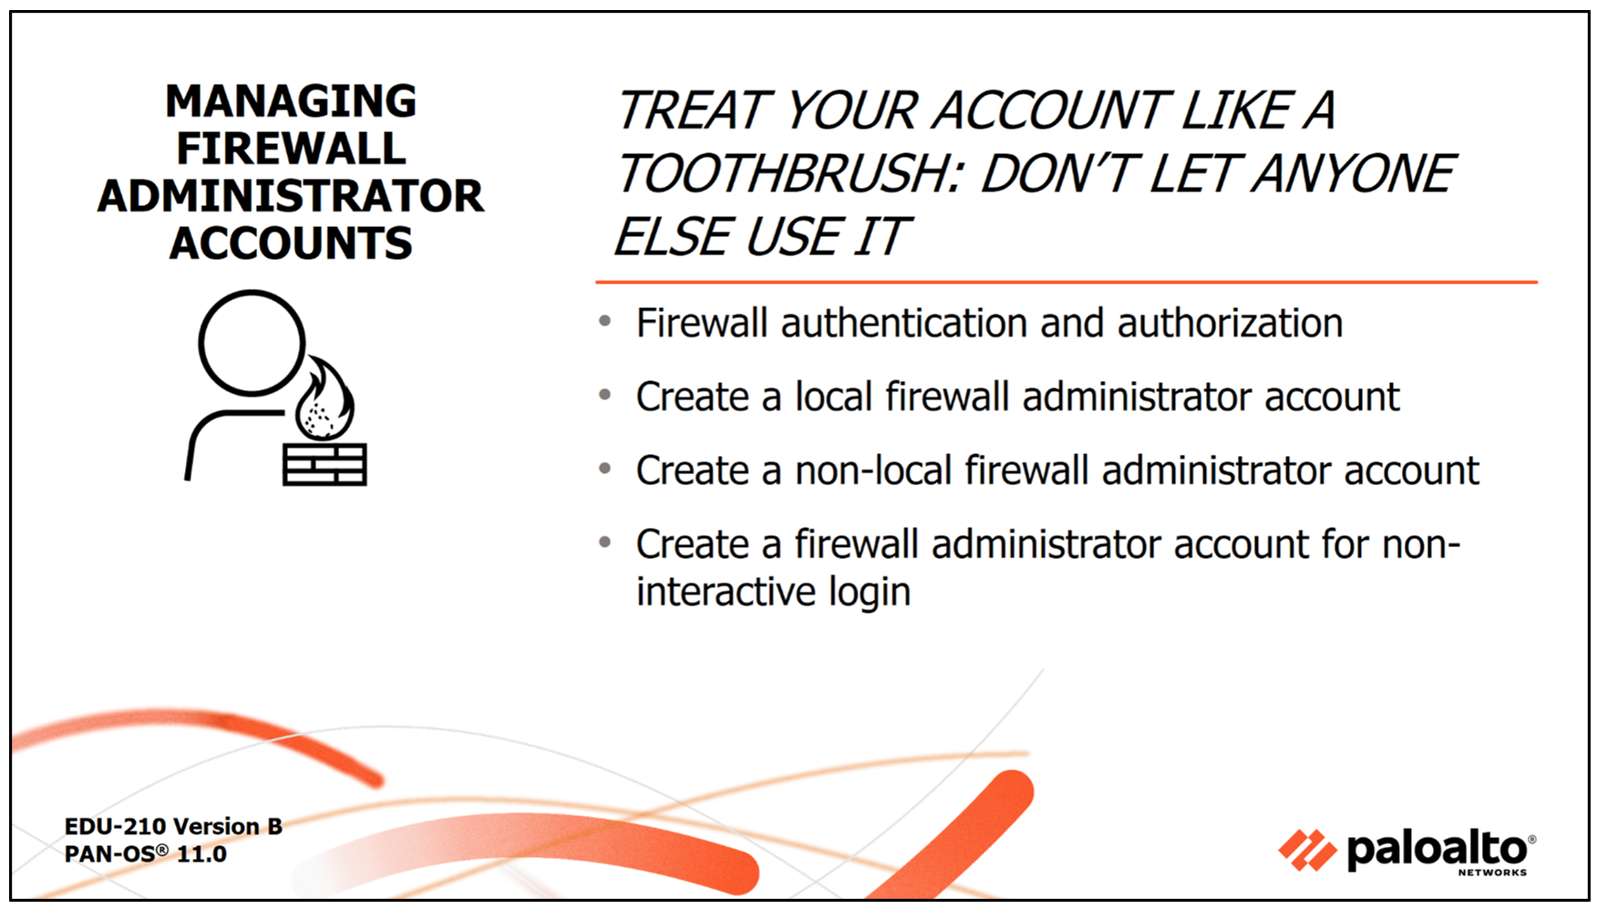

Slide 7
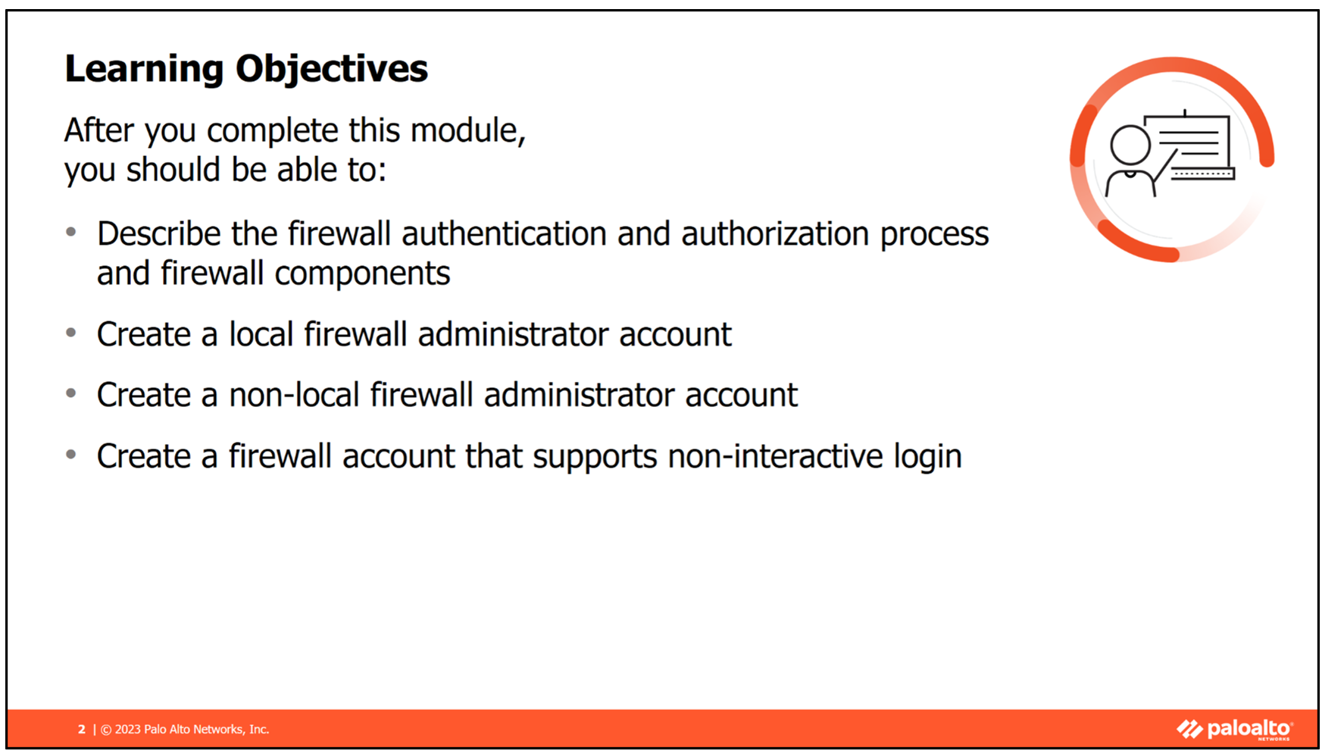
Notes:
This module covers the topics listed here. Read through the list before proceeding.
After you complete this module, you should be able to:
Describe the firewall authentication and authorization process and firewall components
Create a local firewall administrator account
Create a non-local firewall administrator account
Create a firewall account that supports non-interactive login

Slide 8
Treat Administrator Accounts Like a Toothbrush
Each administrator account is personal and should never be shared.
Best Practice:
Use strong, unique passwords.
Rotate credentials regularly.
Assign individual accounts instead of group/shared accounts to ensure accountability.
Why it matters: Shared accounts make it impossible to trace changes or security incidents back to a specific user.

Slide 9
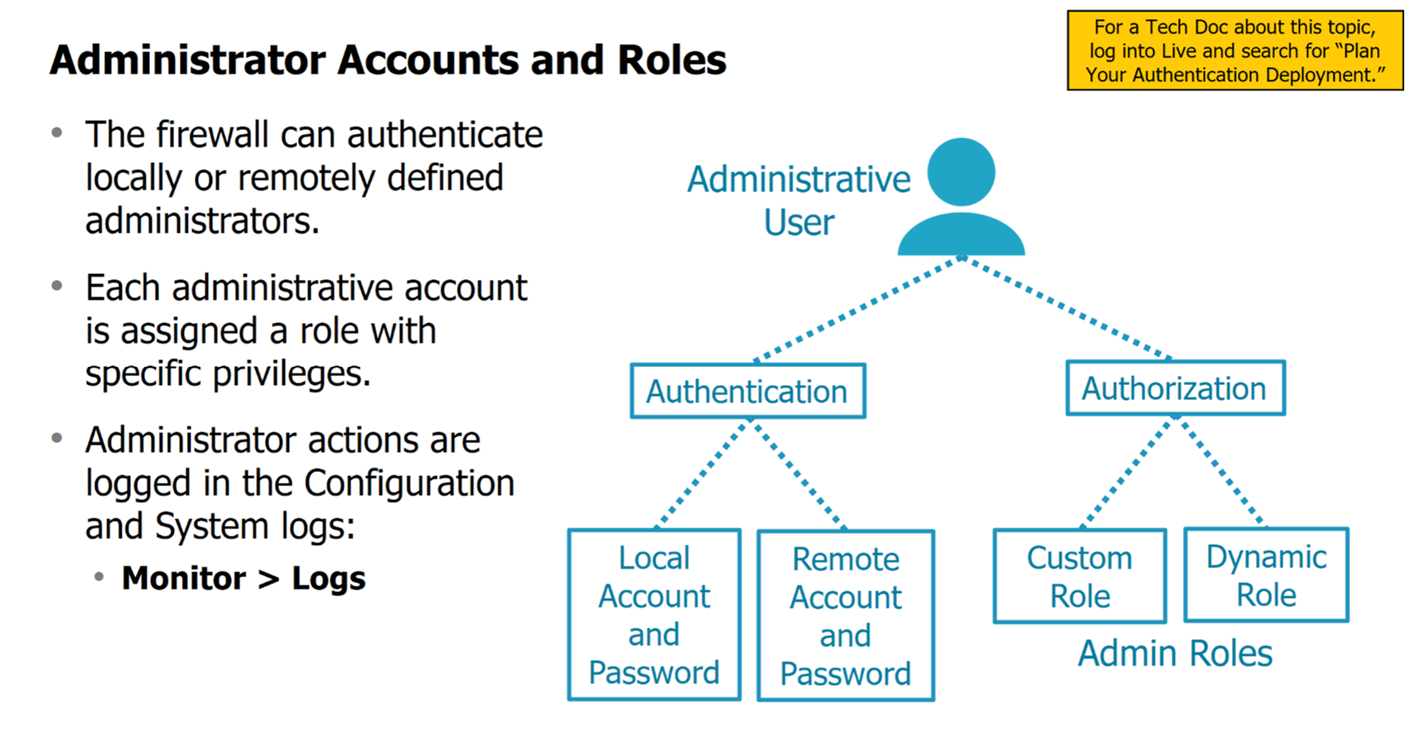
Notes:
By default, only the predefined admin account has access to the firewall. However, you can add administrator accounts to the firewall for delegation and auditing purposes. Each additional administrator account you create can have its administrative privileges. Specify administrative privileges by creating one or more Admin Role Profiles with specific privileges, and then assign an Admin Role Profile to each administrator account.
PAN-OS® software provides flexibility when administrator accounts and admin roles are created. You can create and manage accounts and admin roles locally on the firewall or incorporate a supported authentication, authorization, and accounting service. PAN-OS software supports remote user accounts in Active Directory, Kerberos, LDAP, RADIUS, TACACS+, and SAML. PAN-OS software supports remote role assignment in RADIUS or TACACS+ using Vendor-Specific Attributes (VSAs).
No matter which user changes the running configuration, all changes are logged in the firewall’s System and Configuration logs. The System log records the time an administrator logs in, and the Configuration log records any changes they make.
To create a local administrator account:
Create an Admin Role Profile.
Create a local administrator account.
To create a non-local administrator account:
Create an Admin Role Profile.
Create a Server Profile.
Create an Authentication Profile.
Create an authentication sequence (optional).
Create a non-local administrator account.

Slide 10
Firewall Authentication & Authorization Overview
Authentication: Verifies user identity (username, password, certificate, MFA).
Authorization: Determines what actions an authenticated user can perform.
Logging: All administrative actions are recorded in Configuration and System logs.
Extra Note: This separation follows the AAA model (Authentication, Authorization, Accounting) used in network security.

Slide 11
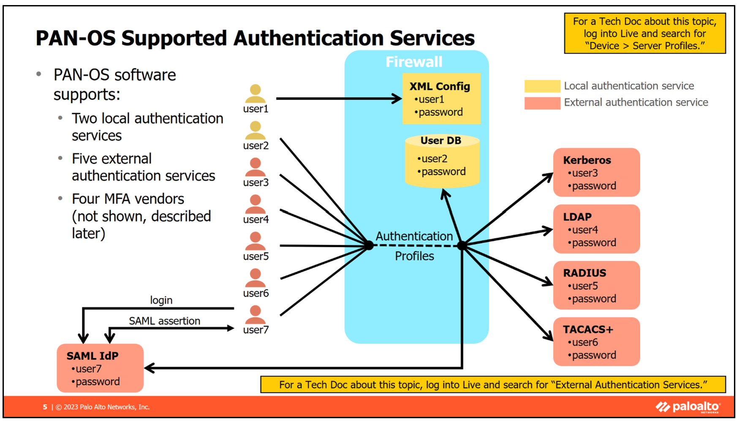
Notes:
PAN-OS software supports three authentication services: local, external, and multi-factor authentication (or MFA).
The local authentication services are labeled “local” because they operate on the firewall itself. There are two local authentication services: local without a database and local with a database.
In local authentication without a database, the administrator’s username and password information is stored on the firewall in the XML configuration file of the firewall. User accounts stored in the XML configuration file can be used only to authenticate logins to the firewall. The firewall cannot use this authentication service to authenticate user traffic flowing through the firewall.
In local authentication with a database, username and password information is stored on the firewall in a local user database. The firewall can use this service to authenticate logins to the firewall and user traffic flowing through the firewall.
The external authentication services are labeled “external” because they operate outside the firewall. Five external authentication services are supported: Kerberos, LDAP, RADIUS, TACACS+, and SAML. The firewall can use all these services to authenticate logins to the firewall and user traffic flowing through the firewall.
You can configure Multi-Factor Authentication (MFA) to ensure that each user authenticates using multiple methods (factors) when accessing highly sensitive services and applications. For example, you can force administrators to enter a login name and password and then enter a verification code that they receive by phone before allowing the administrator to access the web management interface of the firewall. This approach helps prevent attackers from gaining access to or through the firewall. PAN-OS software supports four MFA vendors.
Notice that every authentication service except the local-without-a-database service requires an Authentication Profile. The firewall uses an Authentication Profile to link users to a specific authentication service. Only those authentication services that use an Authentication Profile can authenticate user traffic flowing through the firewall.

Slide 12
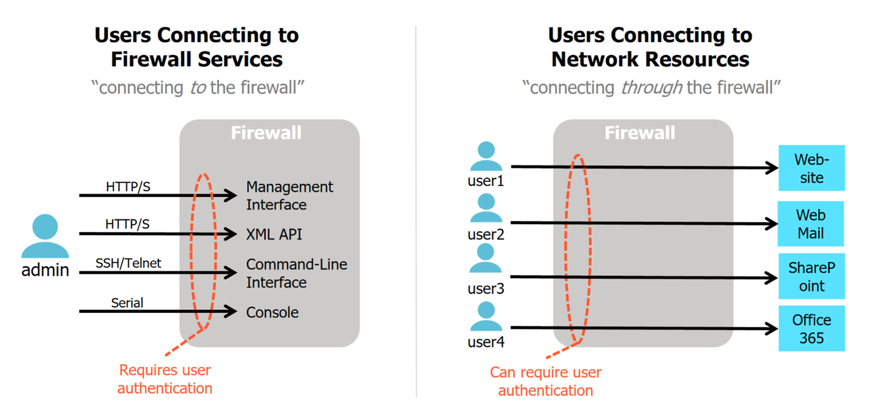
When are Users Authenticated?
Notes:
The firewall authenticates users in two scenarios. First, the firewall authenticates any administrative user connecting to the firewall to access firewall services, such as the firewall web interface. Second, you can configure the firewall to authenticate users accessing network resources through a firewall, such as user1 accessing the internet.
In the first scenario, the firewall verifies user credentials before granting access to services running on the firewall. In the example, the firewall prompts the user admin for their credentials before the firewall grants access to the web interface or XML API interface, the command-line interface, or the console port.
In the second scenario, the firewall can be configured through an Authentication policy to prompt users for their credentials before the firewall grants access to network services. In the example, the firewall prompts user1 for their credentials before it will grant the user access to the website.

Slide 13
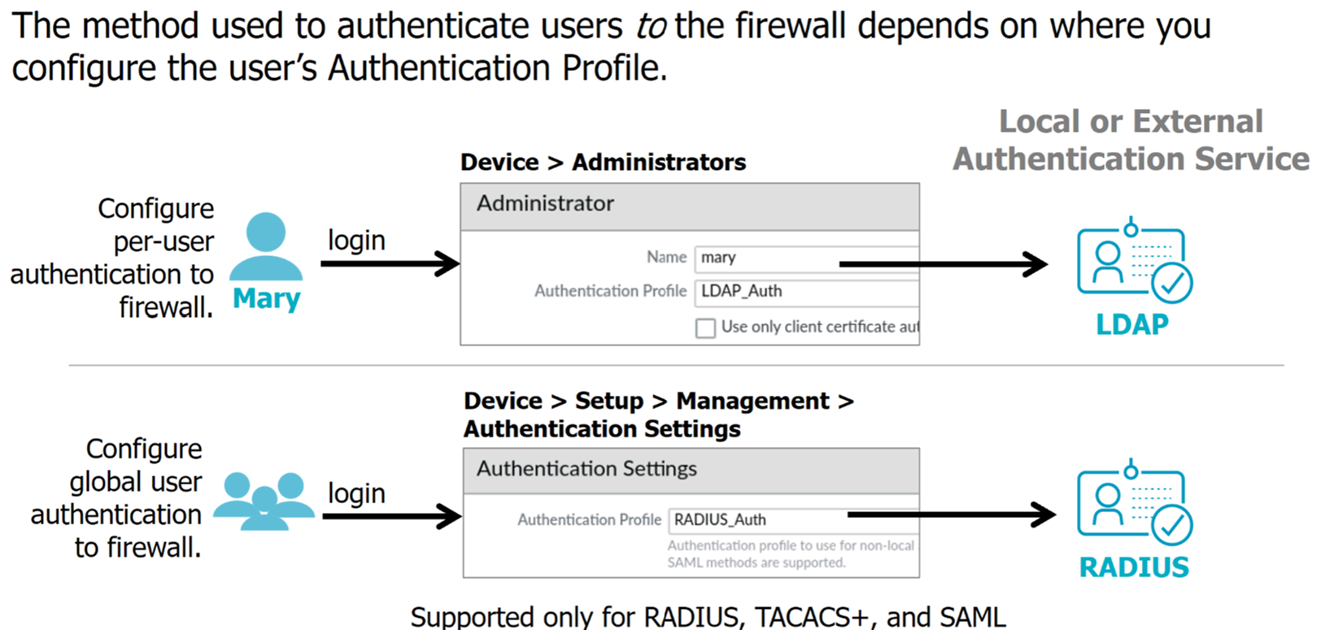
Configure Authentication “to” the Firewall
Notes:
The method used to authenticate users to the firewall depends on where you configure the Authentication Profile of the user. An Authentication Profile defines the authentication service that validates the login credentials. You can configure each user individually on the firewall with their Authentication Profile that points to an authentication service. Or you can configure all users on a firewall to use the same Authentication Profile and authentication service.
To individually configure each user with an authentication service, assign an Authentication Profile to a user account when you add the user account to the firewall. In the example, the user Mary is assigned the Authentication Profile LDAP_Auth, which directs the firewall to use an external LDAP service to authenticate Mary’s credentials.
To configure the firewall to authenticate all users using the same authentication service, assign an Authentication Profile to the authentication settings of the firewall. In the example, the Authentication Profile Radius_Auth is set to the authentication settings of the firewall. All users will have their credentials authenticated by RADIUS. You can configure a firewall's authentication settings to only use RADIUS, TACACS+, or SAML. SAML can authenticate only users using web-based services.

Slide 14
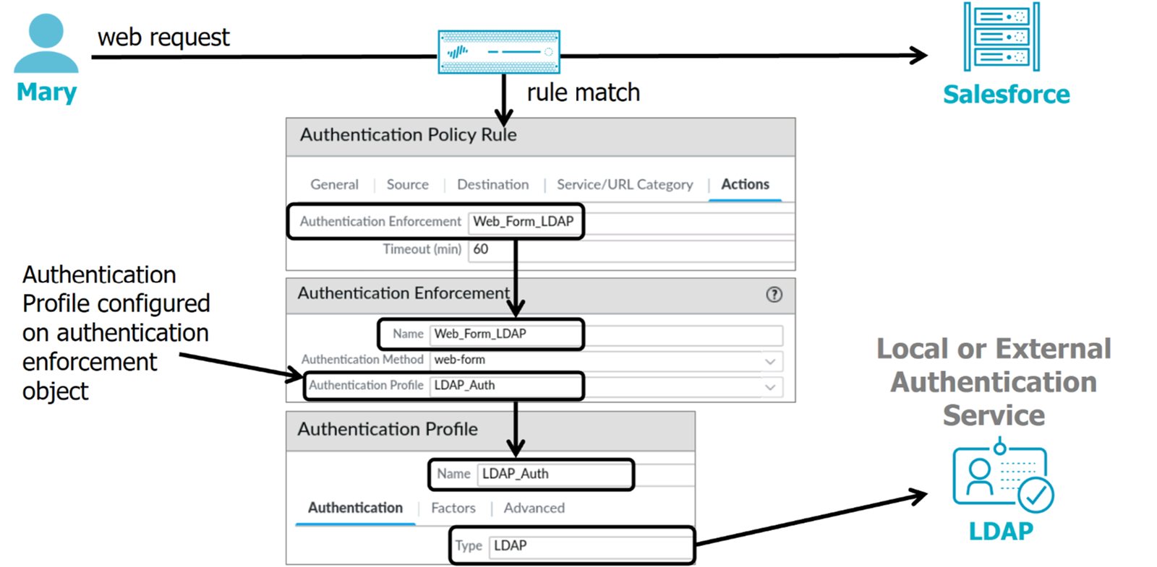
Configure Authentication “through” the Firewall
Notes:
You also can configure the firewall to authenticate user credentials when users attempt to access network resources through the firewall. In this scenario, you do not assign an Authentication Profile to an individual user or the authentication settings of the firewall. Instead, you assign an Authentication Profile to an Authentication policy via an authentication enforcement object. This configuration is shown here.
In the example, Mary attempts to access Salesforce through the firewall. The web request matches a rule in the Authentication policy. The rule’s action is to invoke an authentication enforcement object labeled Web-Form-LDAP. The Web-Form-LDAP object is linked to an Authentication Profile labeled LDAP_Auth linked to an external LDAP service. The firewall will prompt Mary for her credentials and then authenticate those credentials using the LDAP service.

Slide 15
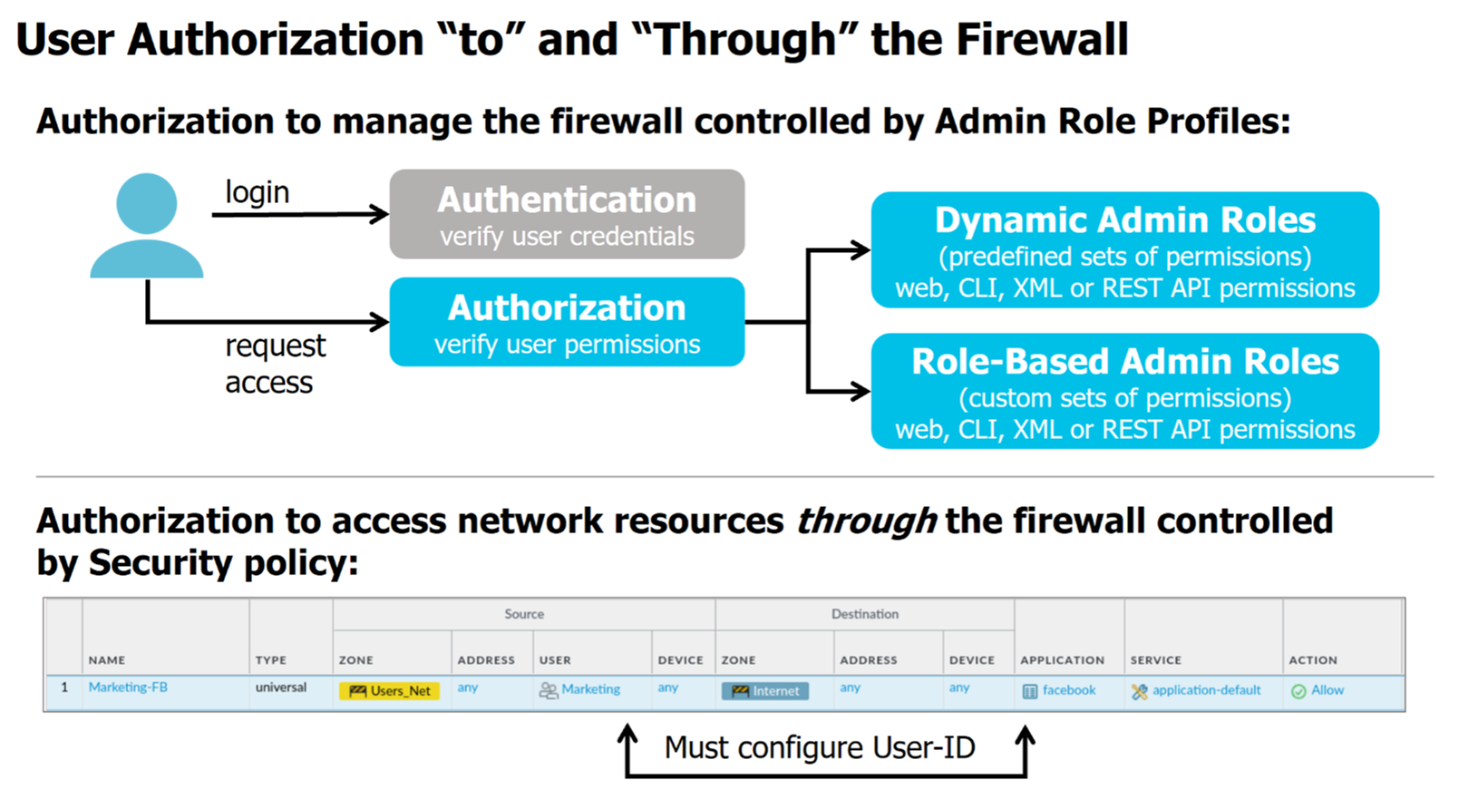
Notes:
After authentication, a user connecting to the firewall will attempt to view information or modify configuration settings. Users can be authorized to perform activities on the firewall through Admin Role Profiles. An Admin Role Profile contains a set of permissions granted to a user when an Admin Role Profile is assigned to the user.
There are two types of Admin Role Profiles. Dynamic Admin Role Profiles are built-in and have a predefined set of permissions. These permissions control what a user can or cannot do on a firewall using the web interface, CLI commands, XML, or REST APIs. When new features are added, the firewall automatically updates the definitions of dynamic roles; you never need to update them manually. Role-Based Admin Role Profiles are custom roles you can configure for more granular access control over the functional areas of the web interface, CLI commands, XML API, and REST API. For example, you can create an Admin Role profile for your operations staff that provides access to the web interface's firewall and network configuration areas and a separate profile for your security administrators that allows access to security policy definitions, logs, and reports.
If you have configured user authentication of traffic flowing through the firewall to network resources, users are granted access to network resources by configuring application-based Security policy rules. You also must configure an Authentication policy to authenticate users accessing network resources through the firewall.

Slide 16
Summary: When Are Users Authenticated?
To the Firewall (Admins):
Management Interface
CLI
Web GUI
API
Through the Firewall (Users):
Access to webmail, Office 365, SharePoint, etc.
Think of it as:
“To” = accessing the firewall itself
“Through” = traffic passing through the firewall

Slide 17
Administrator Accounts and Roles
Recap:
Local Accounts: Credentials stored on the firewall.
Remote Accounts: Credentials stored in external systems (LDAP, RADIUS, TACACS+, SAML, Kerberos).
Roles:
Dynamic Admin Roles → Predefined sets of permissions that update with new PAN-OS versions.
Custom Role-Based Roles → Admin-defined roles with granular permissions.

Slide 18
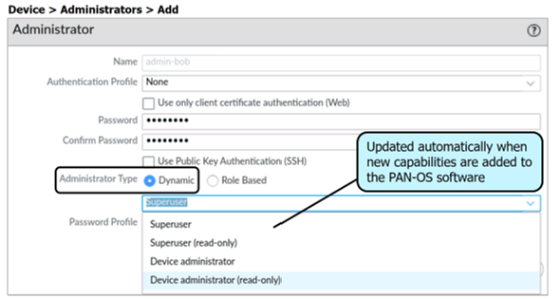
Dynamic Admin Roles
Notes:
There are six Dynamic Admin Roles with predefined privileges labeled Superuser, Superuser (read-only), Device administrator, Device administrator (read-only), and, if your firewall is capable of virtual systems, Virtual system administrator and Virtual system administrator (read-only). These are Dynamic Profiles because they are updated automatically when new capabilities are added to the PAN-OS software, and you cannot manually modify their permissions. The primary permissions difference between the Superuser role and a Device administrator is that a Device administrator cannot define new accounts or virtual systems. A Virtual system administrator can manage only those virtual systems assigned to them. A virtual system administrator cannot access the firewall’s network-level functions such as network interfaces, VLANs, virtual wires, virtual routers, IPSec tunnels, GRE tunnels, DHCP, DNS Proxy, QoS, LLDP, or network profiles. Read-only roles mean you can read (view) data but not modify it.

Slide 19
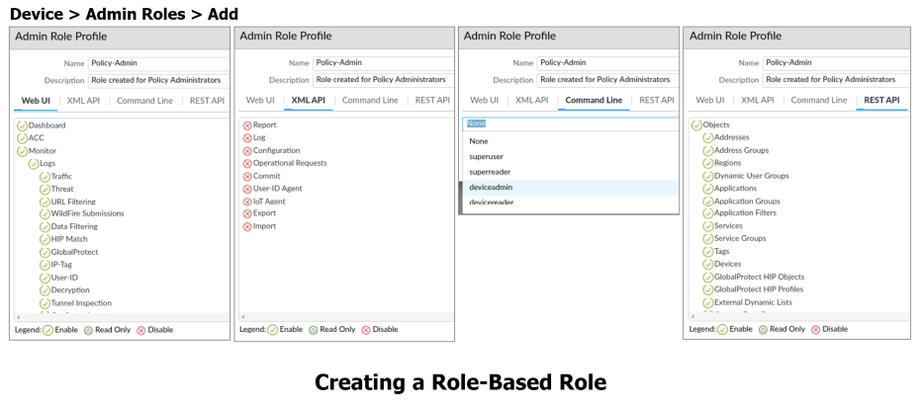
Create Custom Role-Based Admin Roles
Notes:
Use the Device > Admin Roles page to define Role-Based Profiles that specify sets of custom privileges that you assign to administrative user accounts on the firewall.
You define four types of privileges in a Role-Based Profile: Web UI, XML API, Command Line, and REST API. These permissions are represented by four tabs in the web interface, which you use to assign very granular privileges to a Role-Based Profile.
Role-based privileges on the Command Line tab are predefined. No customization is possible. The privileges are:
None: No access granted to the command-line interface
superuser: Full access to the firewall, including defining new administrator accounts and virtual systems. You must have Superuser privileges to create an administrative user with Superuser privileges.
superreader: Read-only access to all options of the firewall
deviceadmin: Full access to all firewall settings except for defining new accounts or virtual systems.
devicereader: Read-only access to all firewall settings except password profiles (no access) and administrator accounts (only the logged-in account is visible).

Slide 20
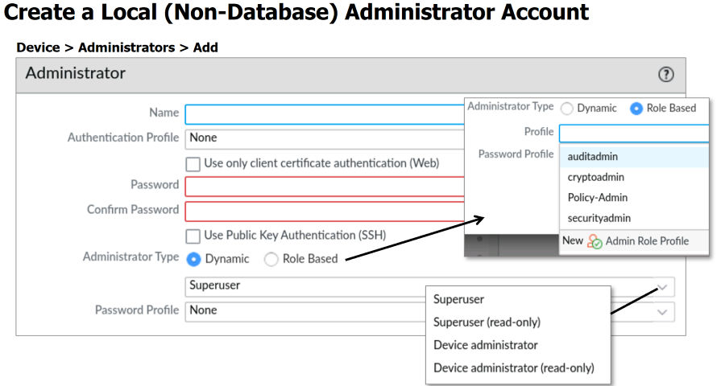
Notes:
Use the web interface to create an administrator account local to the firewall. The privileges of the administrator account are determined by the role profile assigned to the account. The web interface assumes a local account and prompts for a password when you do not select an Authentication Profile.
In this example, a Dynamic Profile is selected, meaning user privileges are defined using one of the predefined roles. These roles affect the web interface and the CLI. The following is a brief description of the predefined roles:
Superuser: All access to all options of the firewall
Superuser (read-only): Read-only access to all options of the firewall
Device administrator: Full access to the firewall except for the creation of virtual systems and administrative accounts
Device administrator (read-only): Read-only access to the firewall except for viewing other administrative accounts
Virtual system administrator: Full access to a specific virtual system. The virtual system administrator does not have control over firewall-level or network-level functions.
Virtual system administrator (read-only): Read-only access to a specific virtual system. The virtual system administrator (read-only) cannot access firewall-level or network-level functions.
To ensure that locally stored passwords are strong and are reset periodically, PAN-OS software enables you to set global minimum password complexity requirements and password-aging values at Device > Setup > Management > Minimum Password Complexity. By default, there are no minimum requirements, and password aging is not enabled.
Those administrator accounts whose passwords might require more frequent resets to meet organizational or legal requirements can be assigned a Password Profile. A Password Profile specifies password-aging values that override the global password-aging values. Configure Password Profiles at Device > Password Profiles.

Slide 21
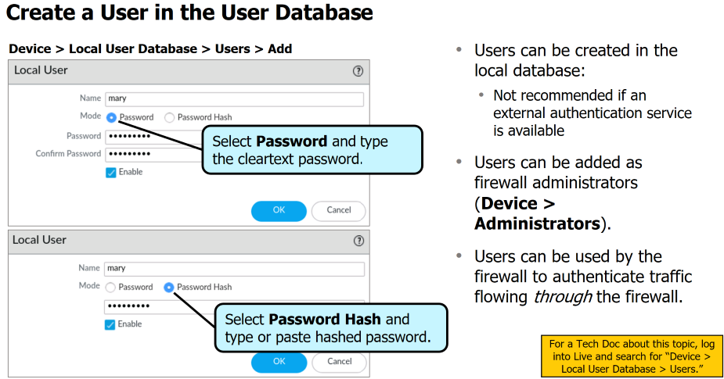
Create a User in the User Database
Notes:
You can add user accounts to a local database on the firewall that stores authentication information for firewall administrators, Captive Portal end users, and end users who authenticate to a GlobalProtect portal and GlobalProtect gateway. Local database authentication requires no external authentication service, with all account management performed on the firewall. The users in the database can be added as firewall administrators, or they can be used to authenticate user traffic flowing through the firewall.
To add a user to the local user database of the firewall, start by browsing Device > Local User Database > Users and click Add. Enter a name to identify the user. Usernames are case-sensitive and can be up to 31 characters in length. Usernames can include alphanumeric characters, spaces, hyphens, and underscores. Each username must be unique within the user database.
In Mode, specify how to enter the password: If you select Password, enter and confirm a cleartext password. If you select Password Hash, type or copy and paste a hashed password string. The Password Hash option is most commonly used if you want to reuse the password from a Linux account but does not know the cleartext password. The firewall can accept any string up to 63 characters in length, regardless of the algorithm used to generate the hash.
Select the Enable check box to activate the user account.

Slide 22
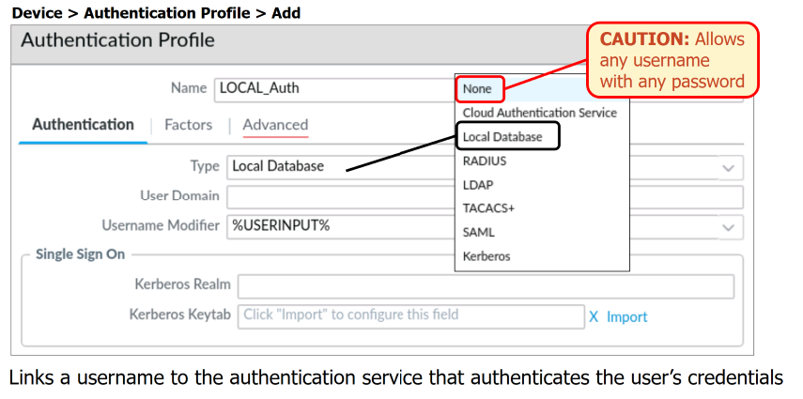
Create a Local Database Authentication Profile
Notes:
An Authentication Profile links a username to the authentication service that the firewall must use to authenticate the user’s login credentials. An Authentication Profile is one of the configuration options that you must choose when you define a firewall user account where the user exists in the local firewall user database.
To create an Authentication Profile, browse to Device > Authentication Profile and click Add. Type the name of the new profile and then configure the Authentication tab. Select Local Database to link to the local user database of the firewall. The field options vary depending on the Type you select from the drop-down list. The available Type options are shown in the screenshot. Select None only in limited scenarios: It is not intended for most users. Selection of None could enable undesired users to log in to your firewall.
For more information about the other options in this window, log into Live and search for PAN-OS admin guide or see PAN-OS Administrator’s Guide at https://docs.paloaltonetworks.com/pan-os/11-0/pan-os-admin.

Slide 23
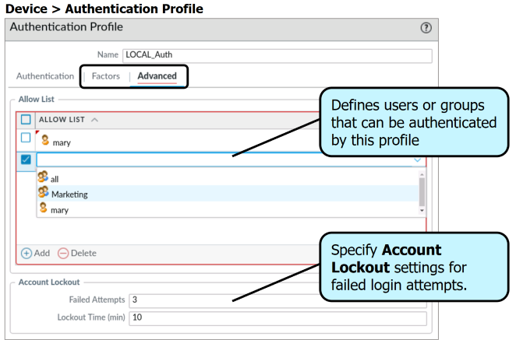
Authentication Profile: Advanced Tab
Notes:
Use the Advanced tab to select specific users and user groups that the firewall can authenticate using this Authentication Profile. You can select all rather than specify a long list of specific users and groups. If you do not add any entries to the list, then no users will be authenticated using this Authentication Profile.
The Failed Attempts option in the Account Lockout section enables you to enter the number of consecutive failed login attempts allowed before the firewall locks the user account, thus preventing the user from accessing the firewall. Limiting the number of login attempts can help protect your network from brute-force login attacks. The default value is 0, which means an unlimited number of login attempts. The range is from 0 to 10.
The Lockout Time (min) option enables you to specify how long the firewall locks a user account after a user reaches the Failed Attempts value. The default value is 0, which means an account will be locked until the administrator manually unlocks the user account. The range is from 0 to 60. Using a value of 0 ensures that a firewall administrator is aware of multiple failed login attempts, but a 0 value can create additional work for an administrator.
You configure the Factors tab as part of MFA.

Slide 24
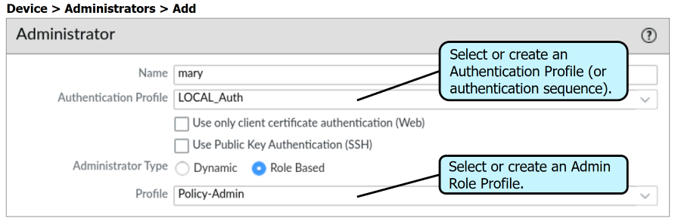
Create an Administrator Account from a Local Database User
Notes:
After adding a user to the local user database and creating an Authentication Profile that links to the local user database, you can create a firewall administrator account based on a local database user. Browse to Device > Administrators and click Add. Type the user’s name as it appears in the local user database, select the Authentication Profile that links to the local user database, and then select either a predefined or custom Admin Role Profile. Because it is a local user, you can specify a Password Profile that controls the user’s password-aging attributes.
Suppose you do not add a local user as a firewall administrator. In that case, the firewall can still use the user information to authenticate user requests for access to network resources through the firewall only and not access to the firewall.
If you select the Use only client certificate authentication (Web) option, then a username and password are not required during login to the firewall web interface. Instead, a user certificate is needed to authenticate user login to the firewall.
If you select the Use Public Key Authentication (SSH) option, an SSH key is required during login to the firewall's command-line interface (CLI). The administrator must generate an SSH public/private key pair on the user’s system. Then the administrator must upload the user’s public key to the firewall. The user’s public key enables the firewall to authenticate the user’s login without requiring the user to enter a username and password interactively. This configuration helps to protect against usernames and passwords being stolen from network traffic.

Slide 25
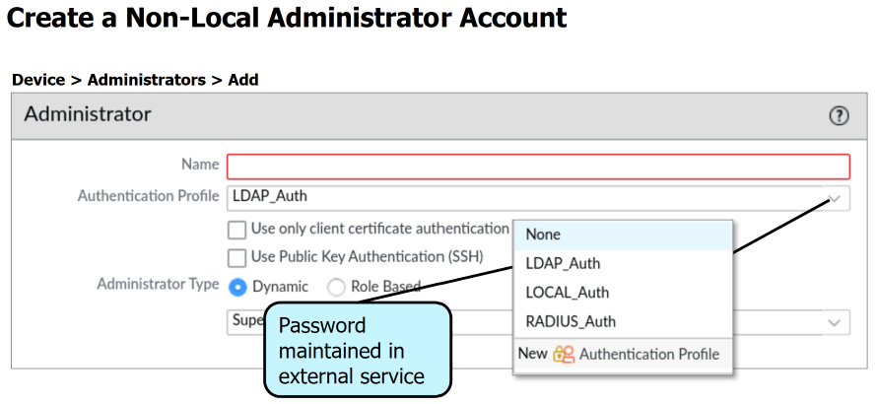
Notes:
You might use the web interface to create administrator accounts whose passwords are maintained in a supported external service. For example, the account password might be kept in Active Directory. To indicate that the account password is held in a supported external service, create an Authentication Profile that connects to an external service and then specify that Authentication Profile when you create an administrator account.

Slide 26
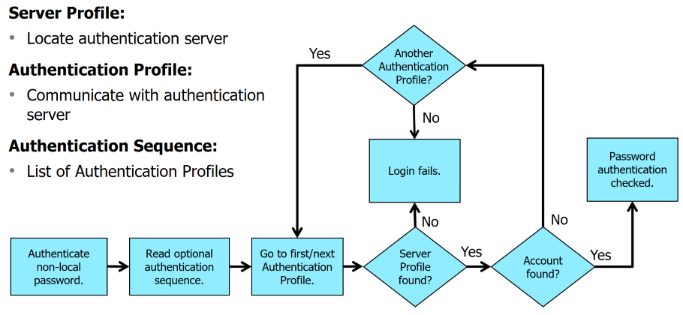
Firewall Authentication of Non-Local Passwords
Notes:
Non-local account passwords must be authenticated through their external authentication service. Before accessing an external authentication service, you must create the appropriate profiles on the firewall. An Authentication Profile contains the information necessary to authenticate an administrator account with an external authentication service after one of the service’s servers has been located. An Authentication Profile uses a Server Profile, which you create to find an external authentication service’s servers. You configure a Server Profile with a list of one or more external authentication service servers.
A firewall can consult multiple external services to authenticate an account. You specify an ordered list of Authentication Profiles by adding them to an optional authentication sequence on the firewall. If you have created an authentication sequence, select the authentication sequence instead of an Authentication Profile when you add a user account on the firewall.
The flowchart shows how a firewall authenticates a non-local account. If the administrator account specifies an authentication sequence, the firewall attempts to authenticate the account using the ordered list of specified Authentication Profiles. Each Authentication Profile specifies a Server Profile with a list of servers for the external authentication service. The firewall connects to each external service until the user is located or no Authentication Profiles are left. If no Authentication Profiles are left, then the login attempt fails.

Slide 27
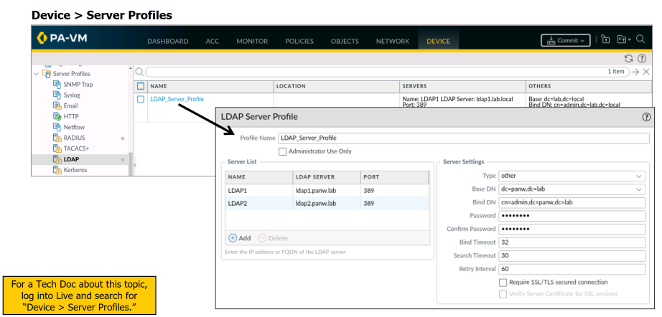
Configure Server Profiles
Notes:
Server Profiles define connections the firewall can make to external servers of specific types. For authentication purposes, you can create Server Profiles for RADIUS, TACACS+, LDAP, Kerberos, or SAML servers.
Authentication Profiles require Server Profiles to validate login information for administrator accounts not created on the firewall.

Slide 28
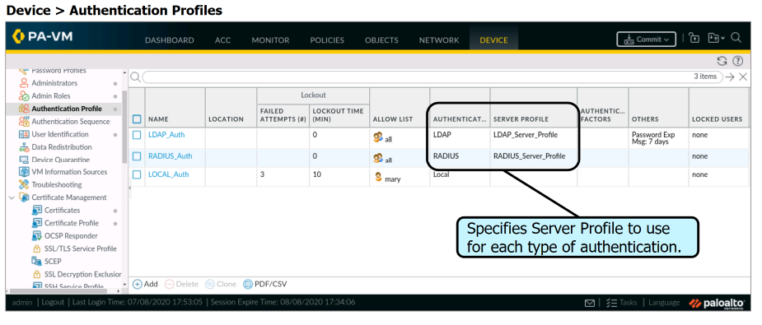
Configure Authentication Profiles
Notes:
An Authentication Profile specifies which authentication server and settings are used to authenticate an administrator account. When you create an administrator account, you specify an Authentication Profile where the account name and password are maintained on an external service.

Slide 29
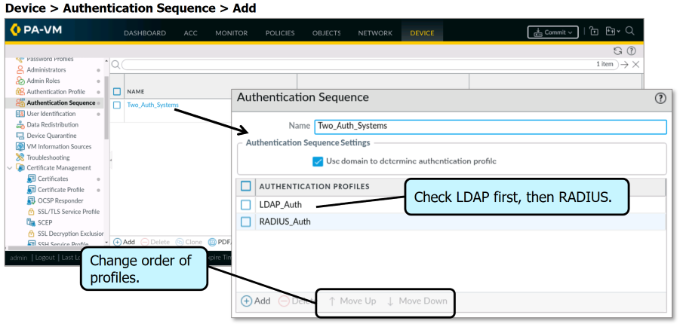
Configure an Authentication Sequence
Notes:
An authentication sequence is optional if you have defined multiple external services. After you have defined your Authentication Profiles, you create the Authentication Sequence that lists the Authentication Profiles that should be checked to authenticate an administrator account and the order in which they should be checked. The Authentication Profiles should be from the most preferred method listed first to the least preferred method listed last. You can use the Move Up button or Move Down button to change the order of the listed profiles.
Suppose you have configured an authentication sequence; the firewall checks against each profile in sequence until one profile successfully authenticates the user. In our example, the firewall will first try to authenticate the user account using the LDAP_Auth profile. If the firewall fails to authenticate the user account using the LDAP_Auth, then the firewall will attempt to authenticate the user account using the RADIUS_Auth profile. A user account is denied access only if authentication fails for all the profiles in the sequence.

Slide 30

Administrator Authentication Methods
Password-based (interactive).
Certificate-based (non-interactive, for web GUI only).
Best Practice: Use certificates for automation/non-interactive logins (e.g., scripts, monitoring tools). Always combine with role restrictions.

Slide 31
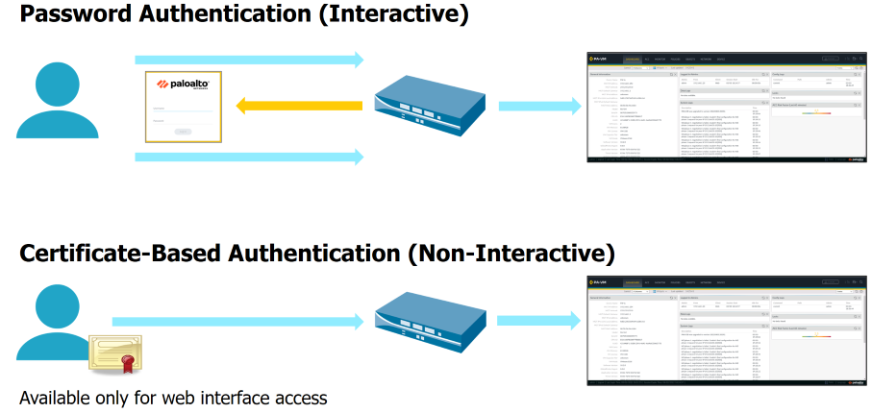
Administrator Authentication Methods
Notes:
Palo Alto Networks firewalls support interactive and non-interactive authentication. In the example at the top, the user attempts to access the firewall. The firewall receives the user’s access request and responds with an interactive authentication page that requires the user to enter a valid username and a password. The credentials can be authenticated locally at the firewall or sent to an external authentication service.
As a more secure alternative to password-based authentication to the firewall web interface, you can configure certificate-based authentication for administrator accounts that are local to the firewall. Certificate-based authentication involves exchanging and verifying a digital signature instead of a password. In the example at the bottom, a user with a client certificate attempts to access the firewall. The firewall receives the user’s access request and transparently uses the client certificate to authenticate the user. This type of authentication occurs locally at the firewall. The user will be granted access if the certificate is deemed valid and the user is authorized to access the service or application.
Certificate-based authentication is available only when the firewall web interface is accessed, not the command-line interface.

Slide 32
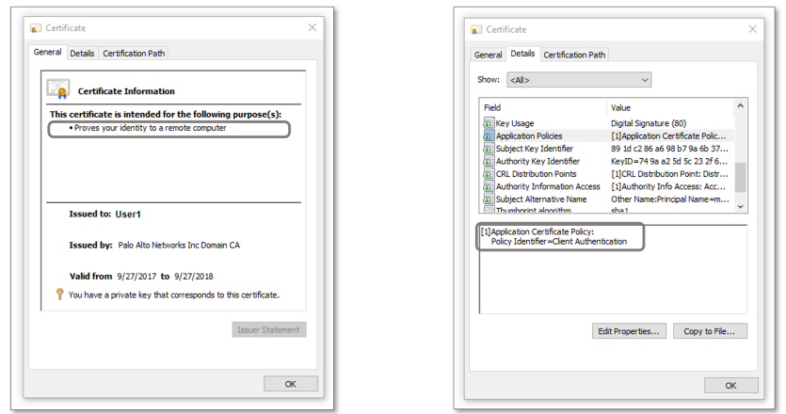
User Certificate
Notes:
You can rely on a certificate and the information and public key it contains when the issuing certificate authority (or CA) is trusted. The signature on a certificate is valid. The receiving entity can recompute and compare the signature to ensure that a certificate has not been intercepted and altered by a malicious third party.
Suppose the certificate of the issuing CA is not added to the certificate store of a client. In that case, the client receives a certificate warning message when browsing secure websites verified by that CA.
After you have generated or imported a CA certificate at the firewall, configure your administrator accounts to use client certificates for non-interactive authentication to the web interface. A step in the process is to generate a client certificate for each administrative account. The root CA certificate will be used during the client certificate generation. You should export the certificate after it has been generated and then import it into the browser on your administrative workstation. Note that the configuration of certificate-based authentication for any administrator will automatically disable the username and password logins for all administrators on the firewall. The administrators will require a certificate to authenticate to the firewall for administrative purposes.

Slide 33
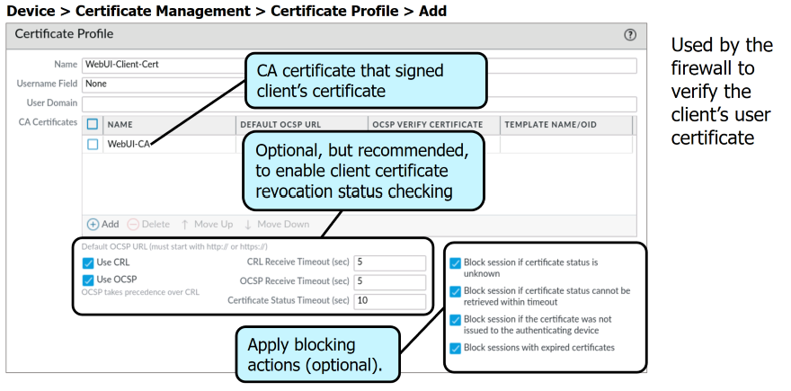
Configure a Certificate Profile
Notes:
A Certificate profile defines the user and device authentication for Authentication Portal, multi-factor authentication (MFA), GlobalProtect, site-to-site IPSec VPN, external dynamic list (EDL) validation, Dynamic DNS (DDNS), User-ID agent and TS agent access, and web interface access to Palo Alto Networks firewalls or Panorama. The profiles specify which certificates to use, how to verify certificate revocation status, and how that status constrains access. You can configure a separate Certificate Profile for each service.
A Certificate Profile can contain one or more certificates. When you configure the certificates that your profile will use for authenticating your administrative accounts, you can either select an existing certificate or import a certificate from your enterprise CA.
A best practice when configuring your Certificate Profile is to enable Online Certificate Status Protocol (or OCSP) and a certificate revocation list (or CRL) for certificate status verification in your Certificate Profiles. OCSP allows the firewall to verify the certificate expiration dates. The firewall checks the revocation status of a certificate, typically using HTTP with a request-response format. The authority responding can reply with a status of good, revoked, or unknown for the certificate. A CRL is a list of serial numbers for certificates that have been revoked. The list is generated and published periodically by the CA that issued the corresponding certificates. If you configure both methods, the firewall first tries OCSP. Suppose OCSP fails to respond within the given time frame in the Certificate Status Timeout field. In that case, the firewall will attempt to verify the certificate’s validity using the CRL method.
Select the Block session if certificate status is unknown check box if you want the firewall to block sessions when the OCSP or CRL service returns a certificate revocation status of unknown.
Select the Block session if certificate status cannot be retrieved within the timeout check box if you want the firewall to block sessions after it registers an OCSP or CRL request timeout.

Slide 34
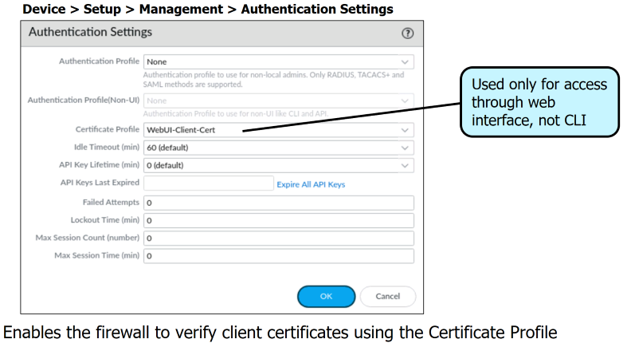
Configure Firewall Authentication Settings
Notes:
After creating your Certificate Profile, browse to Device > Setup > Management and click the Authentication Settings gear icon. For the Certificate Profile, select from the drop-down list the profile you created. Specifying a Certificate Profile enables certificate authentication only for web interface users, not CLI users.
This configuration enables the firewall to verify the client certificates for any administrator accounts you have configured for certificate-based firewall access.
It is important to remember that configuring certificate-based authentication for any administrator will automatically disable the username and password logins for all administrators on the firewall. All administrators will require a certificate to authenticate to the firewall for administrative purposes.

Slide 35
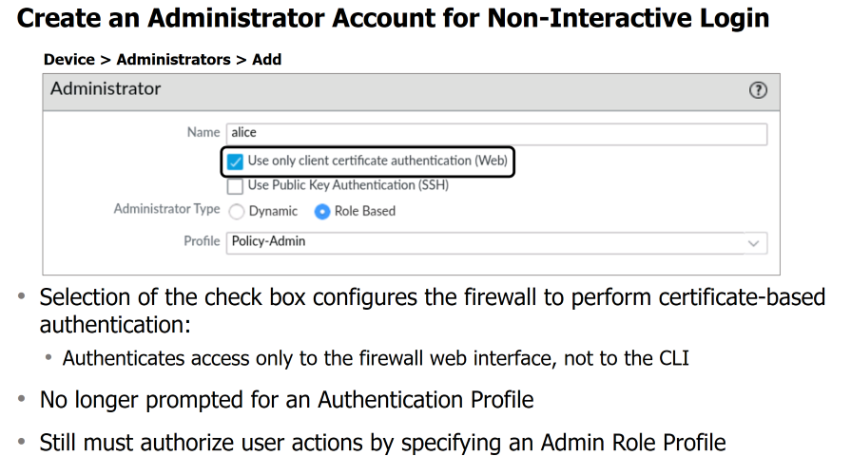
Notes:
To create a firewall administrator account, browse to Device > Administrators and click Add. Enter the user’s name in the Name field.
Select the Use only client certificate authentication (Web) check box to configure the firewall to use certificate-based authentication for this user. Certificate-based authentication replaces all other forms of either local or external authentication. If you select the check box, the Authentication Profile drop-down list is no longer available in this dialog box.
Certificate-based authentication is available only to users accessing the firewall through the web interface. Certificate-based authentication is unavailable for the firewall's command-line (CLI) access.
As is the case with all users who access the firewall, you assign the user either a Dynamic or a Role Based Authentication Profile. The options on the Profile drop-down list vary depending on whether you select the Dynamic or the Role-Based radio button.

Slide 36
Discussion
What are some use cases as to when you would use:
Local Authentication
XML Config File
Local Database
Remote Authentication
LDAP
RADIUS
Kerberos
TACACS +
Non-Interactive Authentication
Certificates
Notes:
Group discussion for 5 minutes. Then class discussion.
Local Accounts: Credentials stored on the firewall.
Remote Accounts: Credentials stored in external systems (LDAP, RADIUS, TACACS+, SAML, Kerberos).

Slide 37
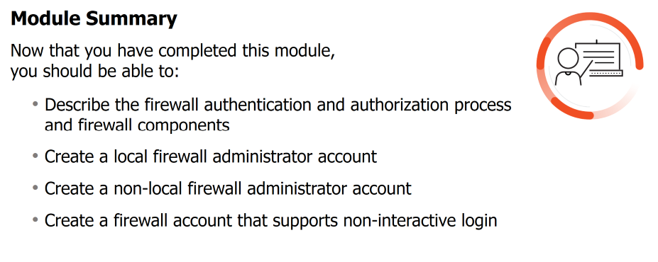

Slide 38
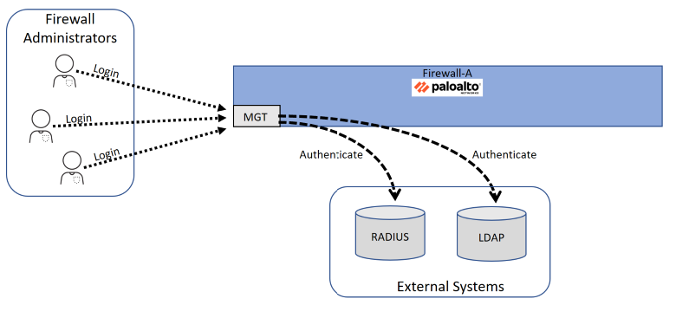
Unit 4 Lab: Overview

Slide 39
Unit 4 Lab: Managing Firewall Administrator Accounts
Load a baseline configuration
Create a local firewall administrator account
Configure an LDAP Server Profile
Configure a RADIUS Server Profile
Configure an LDAP Authentication Profile
Configure a RADIUS Authentication Profile
Configure an Authentication Sequence
Create non-local firewall administrator accounts

Slide 40
End Content

Slide 41
Unit 4 Homework
Always check Blackboard for assignments and when they are due.
Unit 4 Lab: Managing Firewall Administrator Accounts
Unit 4 Quiz

